Slide 1

SPEECH EMOTION RECOGNITION USING ML
CSET 211: Statistical Machine Learning

Slide 2

Our team
Kenneth Lobo
E23CSEU1418@bennett.edu.in
Soham Das
E23CSEU1412@bennett.edu.in

Slide 3
OVERVIEW
Speech Emotion Recognition (SER), as the name indicates, is a tool for determining
the emotions present in various audio samples.
In a variety of audio recordings, including job interviews, caller-agent conversations, streaming movies, and music, speech emotion recognition is utilized to determine the emotional spectrum or sentimental value.
Even music classification or recommendation systems can group songs according to their mood and provide tailored playlists to the consumer.
It is probable to infer that a SER component aids with music suggestions in the
intricate algorithms of Spotify and YouTube.

Slide 4
Table of contents
01
02
DATASET DESCRIPTION
OBJECTIVE
03
04
RESULT ANALYSIS & EVALUATION
WORKFLOW

Slide 5

OBJECTIVE
To build a machine learning model that recognize emotion from speech using the librosa
package, sklearn libraries along with four datasets.
To present a classification models for predicting emotions elicited by speeches
The machine learning model has been trained to classify seven different emotions.

Slide 6
How Business Incorporates SER?
Fosters customization with clients by utilizing the SER algorithm to identify their emotions.
Calls are routed based on the client's feelings. An unhappy caller can have their call forwarded to the retention team.
Automotive is the other domain where emotion recognition is in high demand due to its role in providing riders with a satisfying driving experience.
Delivering business-level analytics that makes recommendations based on
customer’s emotions for choosing between different products.

Slide 7

Business Applications of SER
Market research
Customer reaction to new products
Recruitment
Screening of Candidates
Healthcare Robots
Caregiver Robots,
Emotional Counseling
IoT (Internet of Things)/smart devices
Devices responding to emotions.

Slide 8
DATASET DESCRIPTION Audio Format: .wav Audio Length: 1-3 secs. Data Size: 500 + MB Training : 98% Testing 99%
Toronto emotional speech set (Tess)

Slide 9
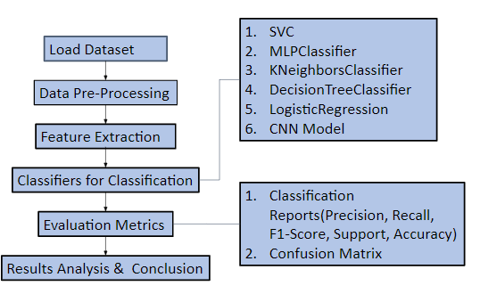
WORKFLOW

Slide 10




DATA PREPROCESSING
EXTRACTING EMOTIONS
FROM EACH DATA FILE.
PASSING THE DATA FILES FURTHER FOR FEATURE EXTRACTION.

Slide 11
Tools Used for Audio Processing
LIBROSA PACKAGE | Librosa library can be used in Python to process and extract features from the audio files. “Librosa” is a python package for music and audio analysis. It provides the building blocks necessary to create music information retrieval systems.
FEATURE EXTRACTION TECHNIQUES | MFCC

Slide 12
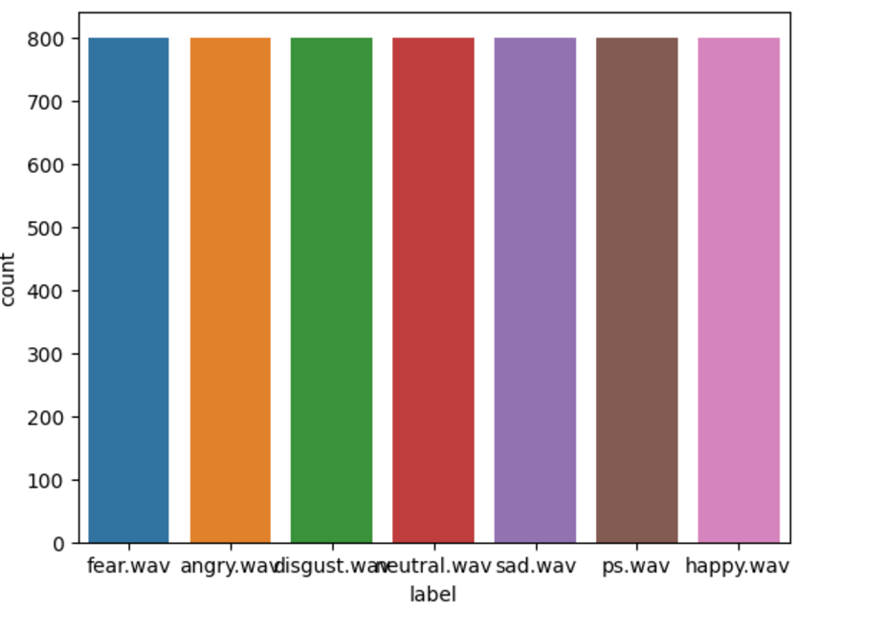
EDA – PART 1
Emotion Counts for Dataset

Slide 13
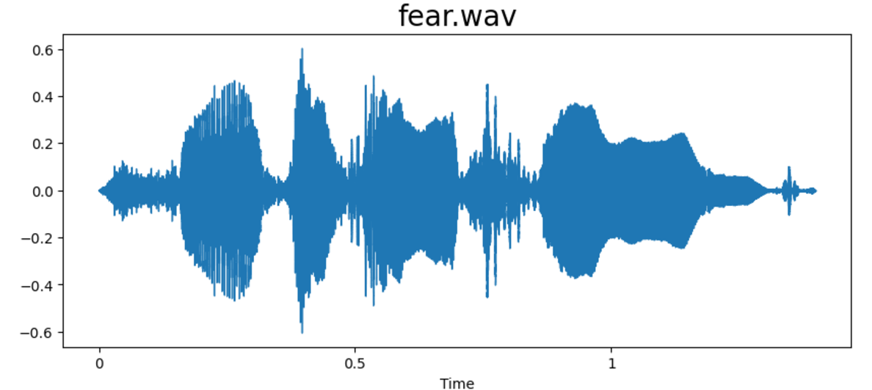
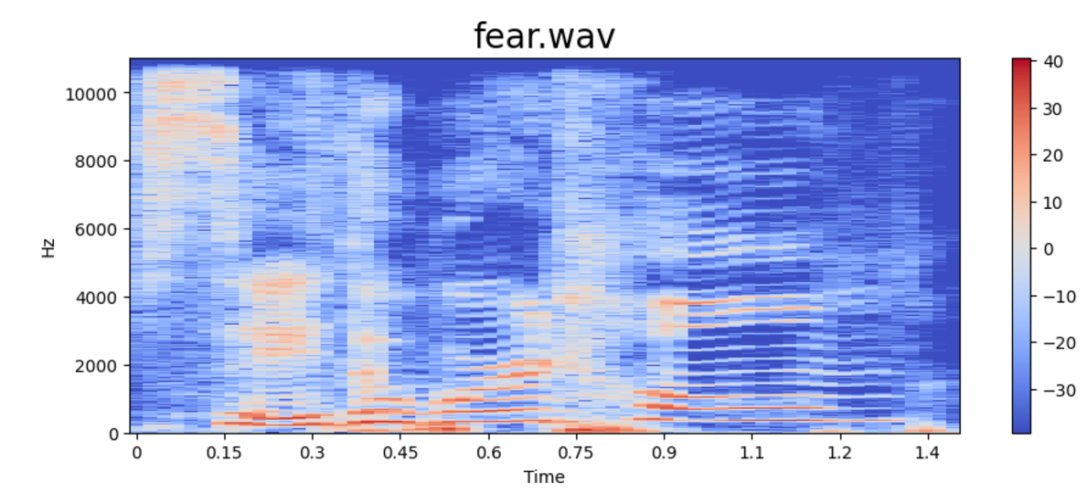
EDA – PART 2

Slide 14
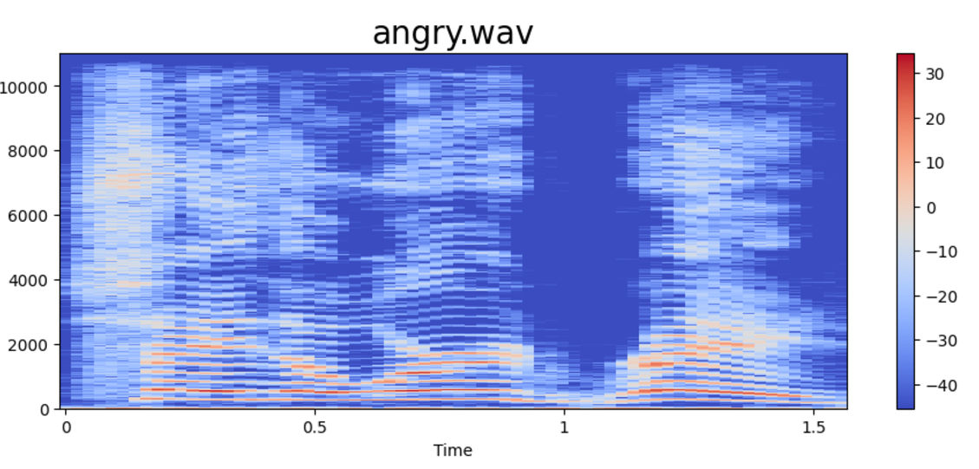
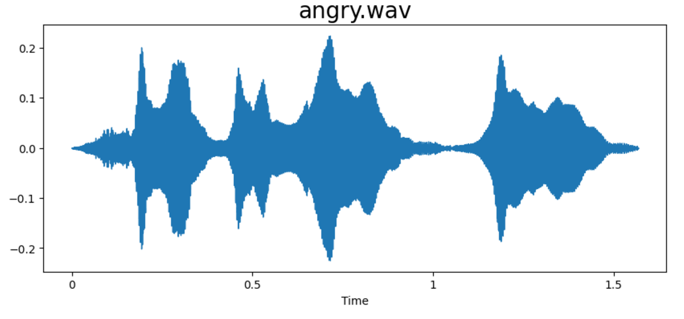
EDA – PART 3
WAVEPLOT AND SPECTOGRAM FOR EACH EMOTION

Slide 15
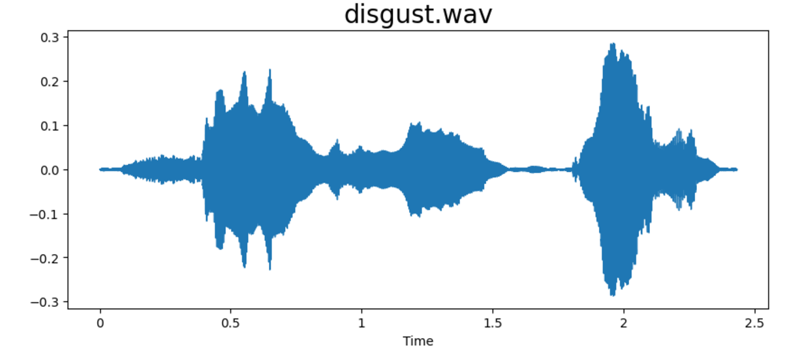
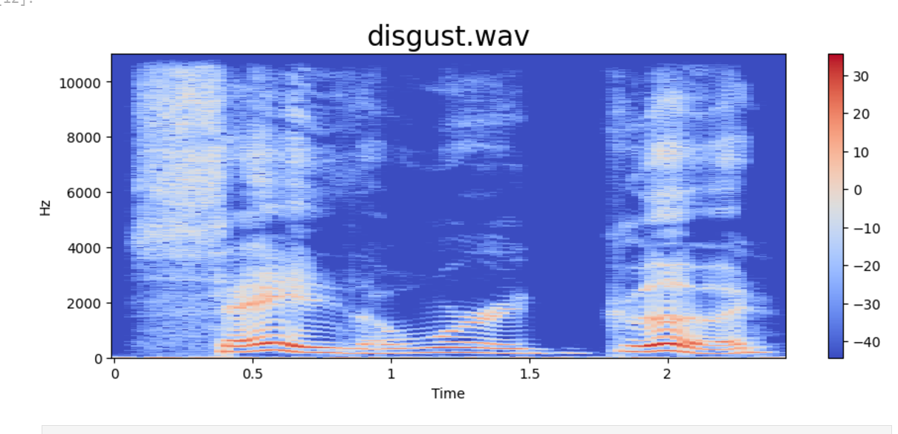
EDA – PART 4
WAVEPLOT AND SPECTOGRAM FOR EACH EMOTION

Slide 16
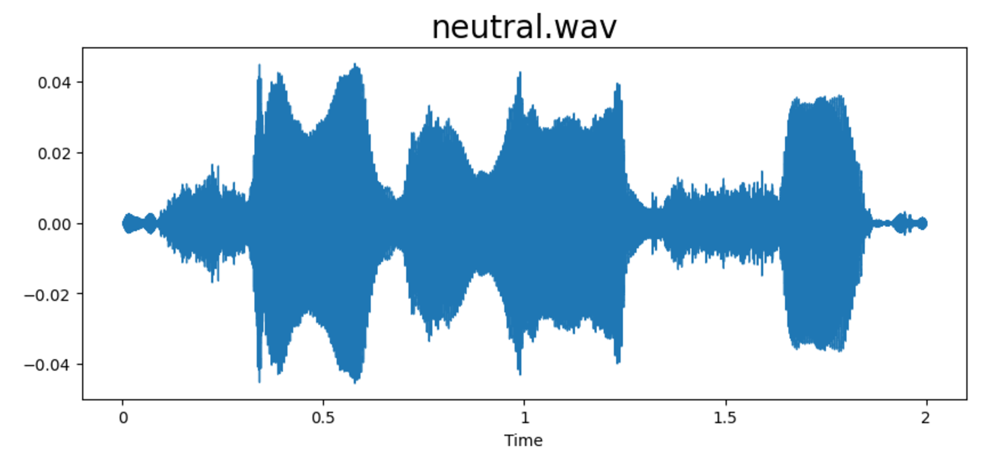
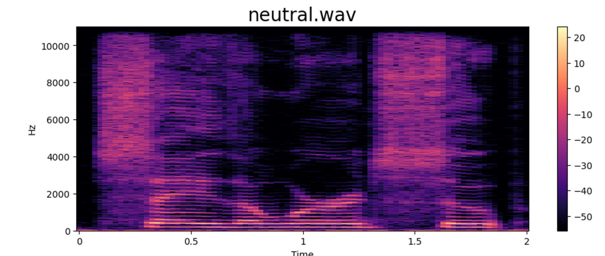
EDA – PART 5
WAVEPLOT AND SPECTOGRAM FOR EACH EMOTION

Slide 17
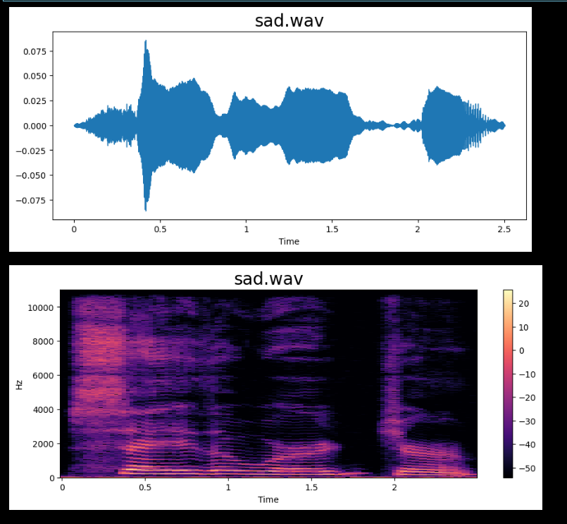
EDA – PART 6
WAVEPLOT AND SPECTOGRAM FOR EACH EMOTION

Slide 18
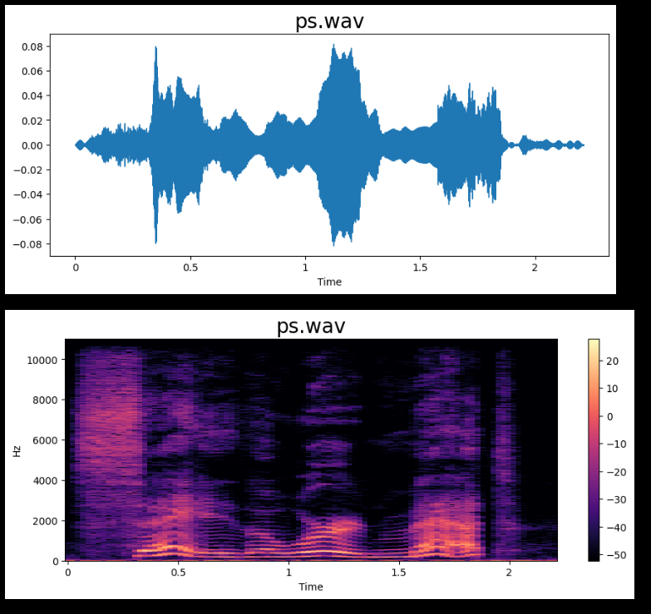
EDA – PART 7
WAVEPLOT AND SPECTOGRAM FOR EACH EMOTION

Slide 19
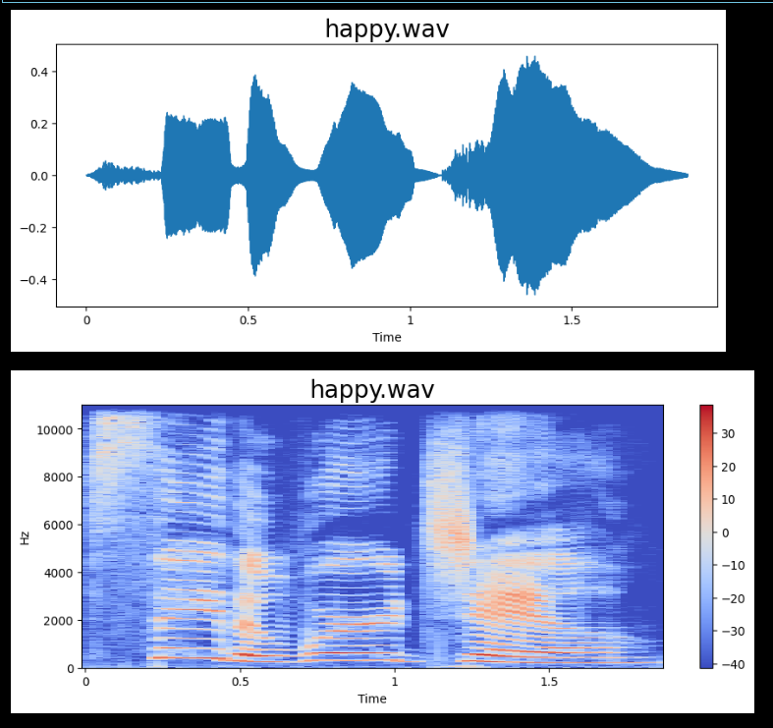
EDA – PART 8
WAVEPLOT AND SPECTOGRAM FOR EACH EMOTION

Slide 20
EVALUATION METRICS
CONFUSION MATRIX:
It compares the actual and predicted classes of the data
CLASSIFICATION REPORT:
It provides the comparison of metric evaluated among different emotions for the data.
PRECISION |  | Precision is the ratio of correctly classified positive samples to total number of classified samples.
RECALL |  | Recall is the ability of a classifier to find all positive instances.
 | F-1 SCORE | The F1 score is a weighted harmonic mean of precision and recall.
ACCURACY |  | It is the number of correct predictions made divided by the total number of predictions.

Slide 21
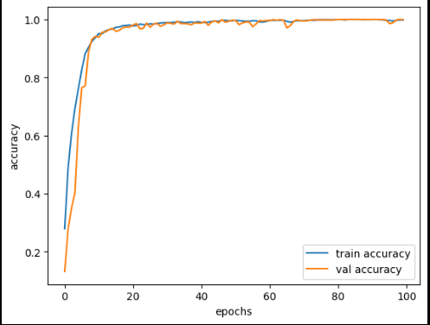
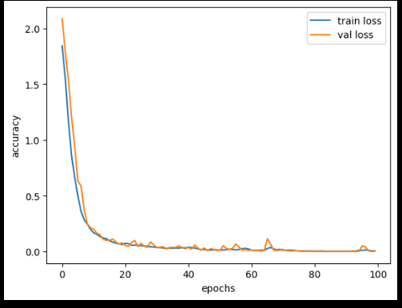
ACCURACY & LOSS AT EACH EPOCH FOR LSTM
LSTM BASE MODEL TRAINING AND
VALIDATION ACCURACY
LSTM BASE MODEL TRAINING AND
VALIDATION LOSS

Slide 22
CONCLUSIONS
When the same audio information is conveyed in a variety of emotions, detecting emotion from audio rather than speech is quite useful.
Tone, rhythm, pitch, frequency, loudness, speed of sound, etc. are the major factors
that determine an auditory feature.
For model simulation, a variety of audio manipulation techniques can be employed to improve the audio's clarity, volume, and time characteristics like shifting and stretching.
Version one base models and version two parameter-tuned models of machine learning models are employed in this study. In certain instances, base models performed better than tuned models, although tuned models had a firm hold on neural network models.
For real-world scenarios in forecasts, accuracy scores of better than 80% are advised by model performance analysis.

Slide 23
REFERENCES
Speech Emotion Recognition (akaike.ai)
Speech Emotion Recognition (SER) through Machine Learning (analyticsinsight.net)
Shengyun Wei et al 2020 J. Phys.: Conf. Ser. 1453 012085DOI 10.1088/1742-6596/1453/1/012085
Open Access proceedings Journal of Physics: Conference series (iop.org)
Parekh, R. (2012). Recognition of Isolated Words using Features based on LPC, MFCC, ZCR and STE, with Neural Network Classifiers (IJMER 2012). Int. Journal of Modern Engineering Research (IJMER). 2012_ijmer-with-cover-page-v2.pdf (d1wqtxts1xzle7.cloudfront.net)
Rawlinson, H., Segal, N., &amp; Fiala, J. (2015, January). Meyda: an audio feature extraction library for the web audio api. In The 1st web audio conference (WAC). Paris, Fr.
meyda-audio-feature-libre.pdf (d1wqtxts1xzle7.cloudfront.net)
Dashtipour, K., Gogate, M., Adeel, A., Larijani, H., &amp; Hussain, A. (2021). Sentiment analysis of persian
movie reviews using deep learning. Entropy, 23(5), 596.
Entropy | Free Full-Text | Sentiment Analysis of Persian Movie Reviews Using Deep Learning (mdpi.com)

Slide 24

THANKS !!

